Slide 1
MINOR PROJECT
Heart Disease Diagnosis
-under the supervision of Dr. Afzal Hussain Shahid
ANKIT GOND 1806016
ANUKUL KUMAR 1806093
RITESH SINGH 1806092

Slide 2
Introduction
The WHO states that cardiovascular diseases are one of the most prevalent causes of death globally and a large number of people die due to this disease every year.
Cardiovascular diseases include deep vein thrombosis, peripheral arterial disease, coronary heart disease, congenital heart disease and rheumatic heart disease.

Slide 3
Heart Disease
31% of the death of people is due to Heart disease around the globe in every year.
Cardiovascular Disease is of two types.
(1) Heart Attack-It occurs when the heart blood vessels are suddenly blocked.
(2) Heart Failure-It results from coronary heart disease, hypertension, cardiomyopathy. Heart failure is basically when the heart is unable to maintain a strong blood flow and this results in chronic tiredness, resist physical activities and shortness of breath. Heart failure can be divided into three types.1. right side heart failure 2. Left side heart failure 3. congestive heart failure.

Slide 4
Cleveland database
This database contains 76 attributes, but all published experiments refer to using a subset of 14 of them.
The "goal" field refers to the presence of heart disease in the patient. It is integer valued from 0 (no presence) to 4. Experiments with the Cleveland database have concentrated on simply attempting to distinguish presence (values 1,2,3,4) from absence (value 0).

Slide 5
Attribute Information:
Only 14 attributes we use
-- 1. #3 (age) age in years
-- 2. #4 (gender) sex (1 = male; 0 = female)
-- 3. #9 (cp) chest pain::1 typical angina 2 atypical angina 3 non-anginal pain 4 asymptomatic
-- 4. #10 (trestbps) resting blood pressure (in mm Hg on admission to the hospital)
-- 5. #12 (chol) serum cholesterol in mg/dl
-- 6. #16 (fbs) (fasting blood sugar > 120 mg/dl) (1 = true; 0 = false)
-- 7. #19 (restecg)

Slide 6
.
-- 8. #32 (thalach) maximum heart rate achieved
-- 9. #38 (exang) exercise induced angina (1 = yes; 0 = no)
-- 10. #40 (oldpeak) ST depression induced by exercise relative to rest
-- 11. #41 (slope)
-- 12. #44 (ca) number of major vessels (0-3) colored by fluoroscopy
-- 13. #51 (thal) 3 = normal; 6 = fixed defect; 7 = reversible defect
-- 14. #58 (num) **this is the predicted attribute

Slide 7
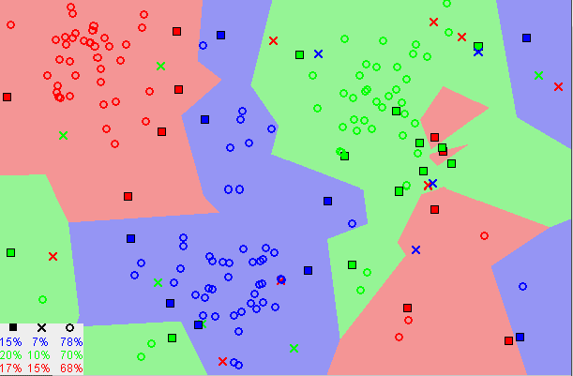
KNN CLASSIFICATION
KNN is a supervised Machine Learning Algorithm and can be used to solve classification as well as regression problems.
This method of classification assumes that similar things exist in
close proximity.
KNN classification means classification based on k nearest
neighbours.
K is the input parameter initialized by the user.
A typical knn classification at work

Slide 8
What are the varying parameters?
KNN
n_neighbors | Weights | Algorithm
Range(1,21) | uniform | auto
 | distance | Kd_tree
 |  | Ball_tree

Slide 9
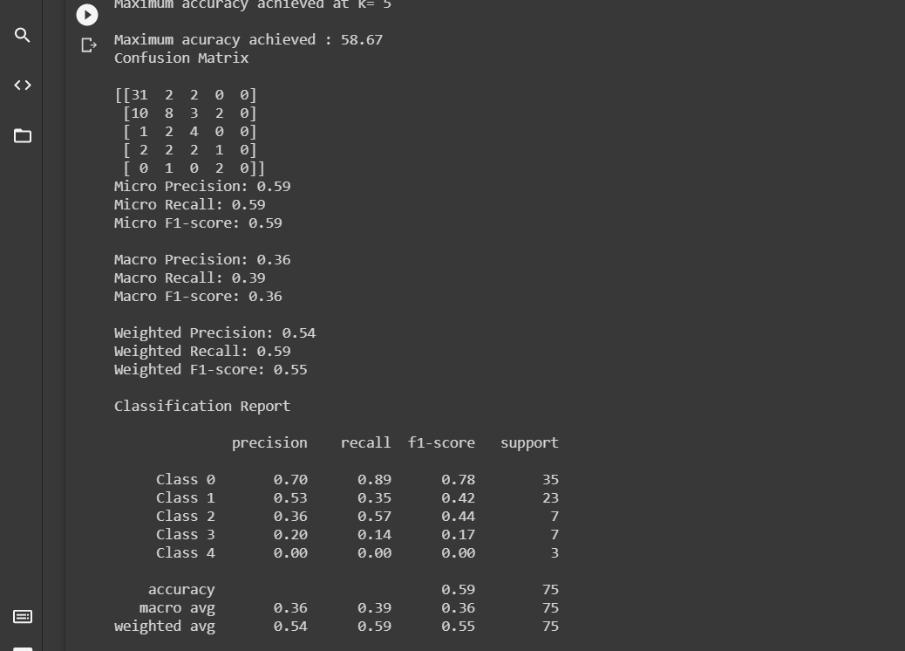
Setting parameter weights=‘uniform’

Slide 10
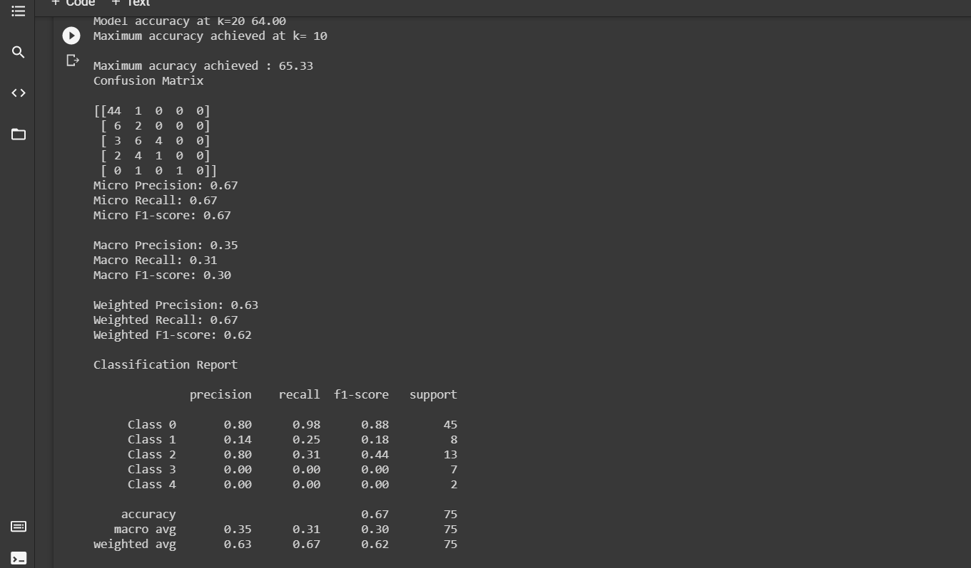
Setting parameter weights=‘distance’

Slide 11
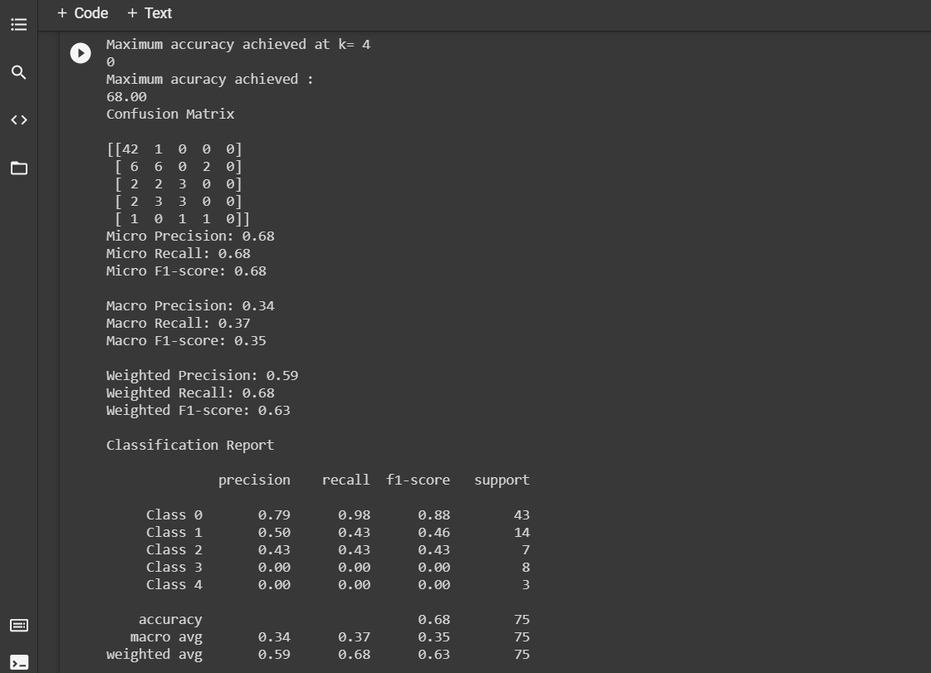
Further Tuning of parameters

Slide 12
Accuracy attained by tuning
weights | n_neighbors | algorithm | accuracy
weights=’uniform’ (fixed) | 5 | - | 58.67
weights=’distance’ (fixed) | 10 | - | 65.33
*weights=’uniform’ | 4 | auto | 68%
* represents the maximum accuracy attained for all the possible combinations.

Slide 13
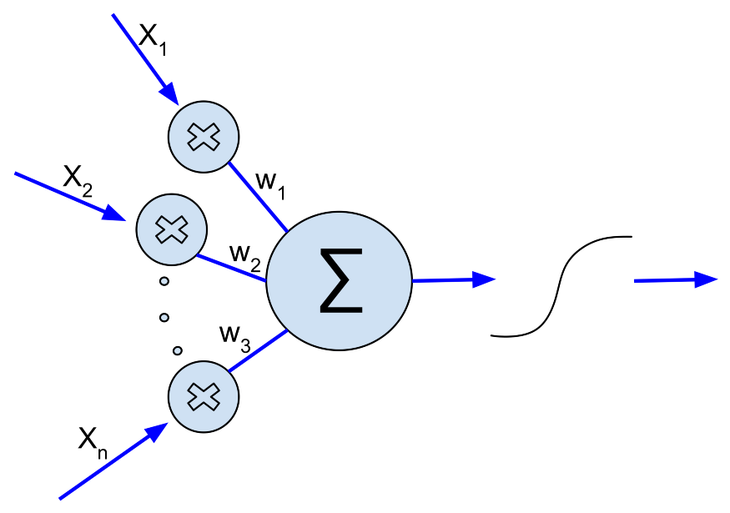
Artificial Neural Network (ANN)
Artificial Neural Network (ANN) is a deep learning algorithm that emerged and evolved from the idea of Biological Neural Networks of human brains.
A neural network having only one layer is called perceptron.
A multilayer perceptron is called Artificial Neural Network.
An ANN can consist of any number of layers.
Each layer can have a number of neurons.
Each neuron is connected with each and every other neuron.

Slide 14
ARTIFICIAL NEURAL NETWORK (ANN)
Implementation using keras Library.
What are the varying parameters?
No of Hidden Layers
Input and Output Size
Loss Function and Optimizer
Fitting / Epochs
How we are going to tune parameters:
2 or 3 hidden layers
Varying Input size
Choosing different Optimizers
Running different epochs

Slide 15
Network with 2 hidden layer
No of hidden Layers | Ist layer dimension | 2nd Layer Dimension | Output Layer | Optimizers | Epochs | Accuracy obtained
2 | 13 | 12 | 5 | Adam | 100 | 66.7
2 | 13 | 12 | 5 | Adam | 200 | 56.6
2 | 13 | 12 | 5 | SGD | 100 | 63.4
2 | 13 | 12 | 5 | SGD | 200 | 53.2
2 | 13 | 8 | 5 | Adam | 100 | 70.8
2 | 13 | 8 | 5 | Adam | 200 | 56.1
2 | 13 | 8 | 5 | SGD | 100 | 60.7
2 | 13 | 8 | 5 | SGD | 200 | 66.3

Slide 16
Network with 3 hidden layer
No of hidden Layers | Ist layer dimension | 2nd Layer Dimension | 3rd Layer Dimension | Output Layer | Optimizers | Epochs | Accuracy obtained
3 | 16 | 12 | 8 | 5 | Adam | 100 | 50.0
3 | 16 | 12 | 8 | 5 | Adam | 200 | 63.3
3 | 16 | 12 | 8 | 5 | SGD | 100 | 46.7
3 | 16 | 12 | 8 | 5 | SGD | 200 | 66.4
3 | 13 | 12 | 8 | 5 | Adam | 100 | 56.7
3 | 13 | 12 | 8 | 5 | Adam | 200 | 53.3
3 | 13 | 12 | 8 | 5 | SGD | 100 | 63.3
3 | 13 | 12 | 8 | 5 | SGD | 200 | 50.0

Slide 17
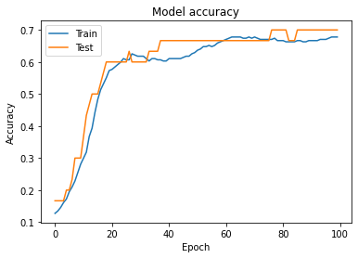
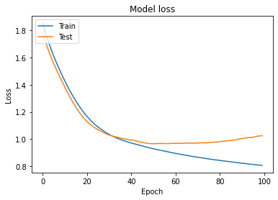
Plot of variation of model accuracy and loss with epochs

Slide 18
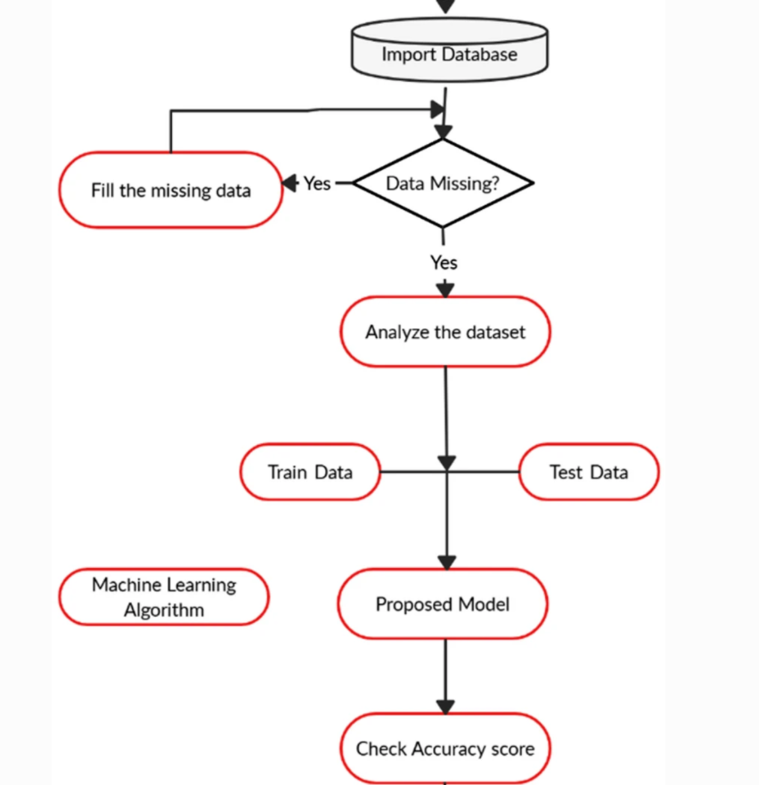

Slide 19
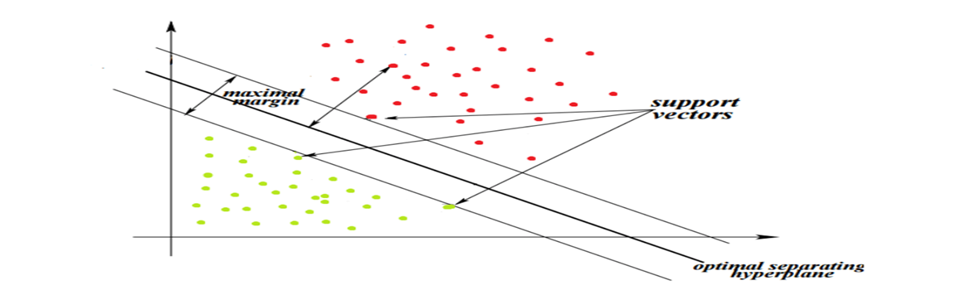
Support Vector Machine(SVM)
Support Vector Machine (SVM) is a Supervised Machine Learning Algorithm used for classification and/or regression.“The goal of the SVM algorithm is, to create the best Hyperplane.

Slide 20
SVM
Tuning parameters in SVM-
Gamma(10^-9 to 10)
C(10^-9 to 10)
Kernel function(RBF,Poly,Linear)

Slide 21
Setting kernel=‘RBF’,‘Poly’,‘Linear’
For each Gamma in range(10^-9 to 10) we changed the value of C(10^-9 to 10)
The model attained a maximum accuracy of
67.21% at Gamma=0.01 and C=10;
The model attained a maximum accuracy of
62.29% at Gamma=0.1 and C=10;
The model attained a maximum accuracy of
65.5% at Gamma=0.000000001 and C=1;

Slide 22
Setting ‘Auto’
For each Gamma in range(10^-9 to 10) we changed the value of C(10^-9 to 10)
The model attained a maximum accuracy of
67.21%

Slide 23
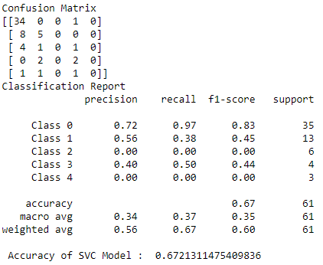
Confusion_Matrix and Classification Report

Slide 24
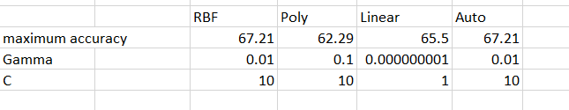
Final Result

Slide 25

Naive Bayes
Naive Bayes classifiers are classifiers based on Bayes’ theorem. The model generated is probabilistic. It estimates conditional probability which is the probability that something will happen, given that something else has already occurred.
Naive Bayes is a classification algorithm based on Bayes’ Theorem.
Bayes Theorem::
P(A)-probability of A;
P(B)-probability of B;
P(A/B)-probability of A given B;
P(B/A)-probability of B given A;

Slide 26
Naive Bayes
Tuning parameters in Naive-Bayes
:Alpha(10^-9 to 100)
:Var_smoothing(10^-9 to 100)

Slide 27
Setting Bernoulli Naive Bayes
For each Alpha in range(10^-9 to 10)
The model attained a maximum accuracy of
57.69% at Alpha=11;

Slide 28
Setting Multinomial Naive Bayes
For each Alpha in range(10^-9 to 10)
The model attained a maximum accuracy of
55.79% at Alpha=1;

Slide 29
Setting Gaussian Naive Bayes
For each Var_Smoothing in range(10^-9 to 10)
The model attained a maximum accuracy of
61.53 at Var_Smoothing=0.000000001;

Slide 30
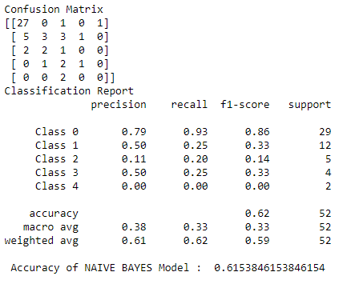
Confusion Matrix and Classification Report

Slide 31
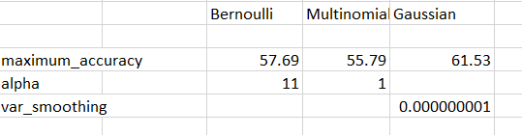
Final Result:

Slide 32
Random Forest
Random forest is a supervised machine learning algorithm that constructs several decision trees. The final decision is made based on the majority of decision tree.

Slide 33
It has been used in prediction and probability estimation. Consist of many decision tree and each tree gives a vote that indicate the decision about class of the object.
First proposed by Tin kam Ho of bell labs in 1995.
This method combine bagging and random selection of features.

Slide 34
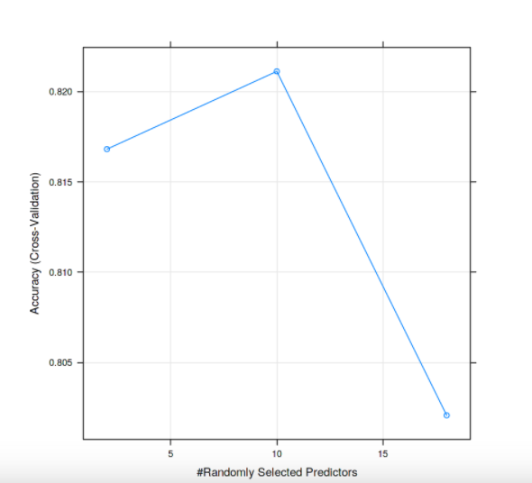

Slide 35
Conclusion
Random Forest data mining algorithm was implemented for prediction of heart Disease.
From the experimental work we obtained the accuracy of 60.4 % for prediction of heart disease with diagnosis rate of 93.3% using random forest algorithm.

Slide 36
Thank You

